Slide 1
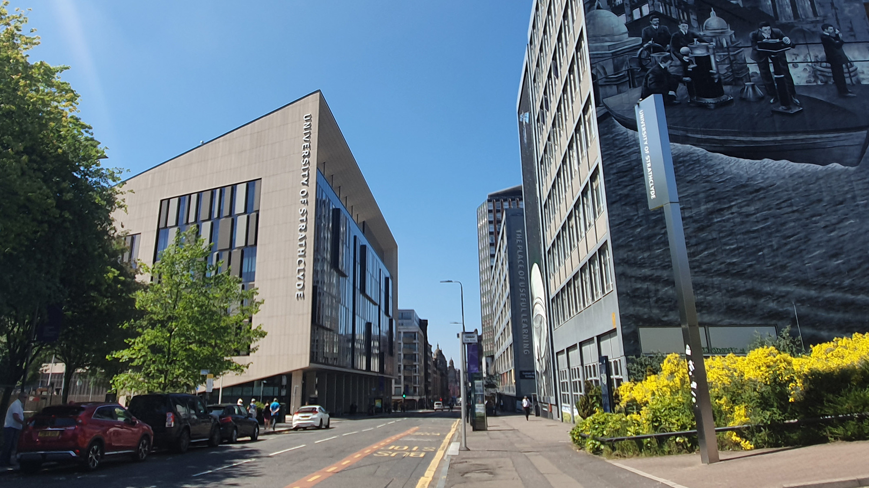

DSP Principles 2023/2024
EE469/EE669/EE869/EE969
Module Introduction
carmine.clemente@strath.ac.uk

Slide 2
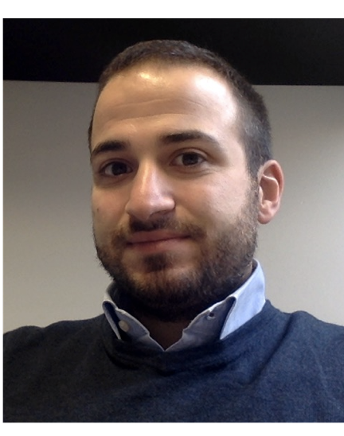
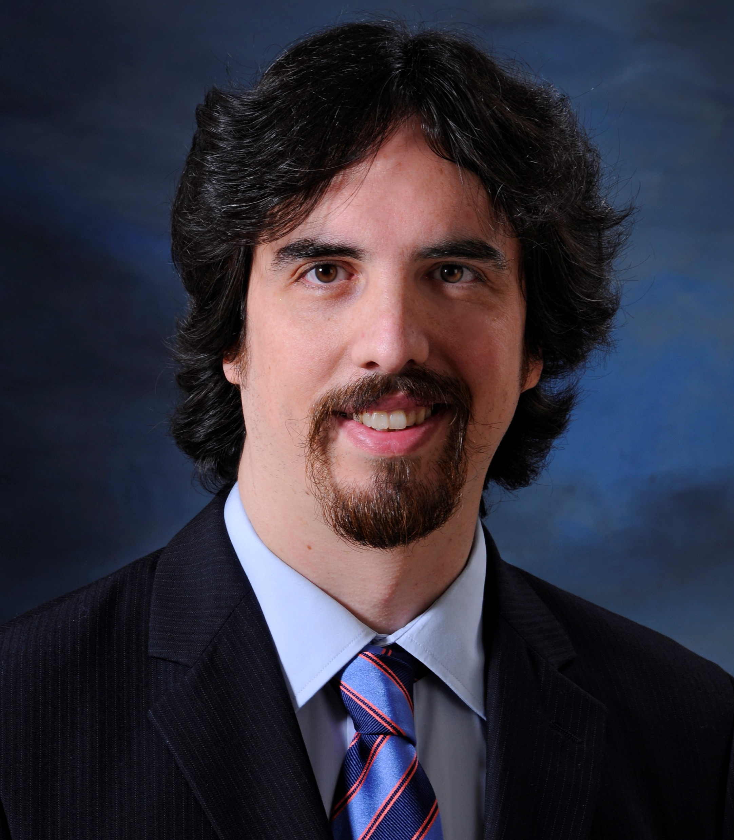

Academic Team
Dr Carmine Clemente – Reader
Director of Sensor Signal Processing & Security Labs
Area of expertise: Radar signal processing.
Dr Jaime Zabalza – Lecturer – Chancellor’s Fellow
Area of expertise: Artificial Intelligence, Hyperspectral Imaging.
Dr Christos Ilioudis – Research Fellow
Holder of the Royal Academy of Engineering IC Security Fellowship
Area of expertise: Radar signal processing.

Slide 3




Teaching Assistants
James McCleary
Elmergue Germano
Finlay Rollo
Hemanga Banerjee

Slide 4
DSP in EEE at Strathclyde
Inst (SSC) Sensors, Signals and
Communications
Inst EE
Energy & Environment
CIDCOM
Comms
CeSIP
S&I Proc
CMP
Mems&Photonics
CUE
Ultrasonics

Slide 5


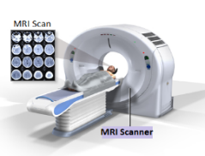
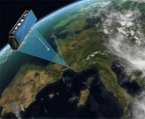
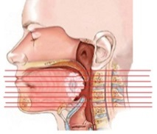
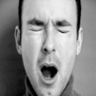
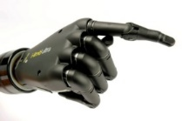
DSP going on in CeSIP
Dr Clemente
Dr Iloudis
Dr Di Caterina
Dr Kirkland
ML&DL/SNN
Radar, Remote Sensing & Security
Biomedical Imaging
Speech, Image and Video Processing
Biosignals ECG, EMG, Speech
Sensor Signal Processing & Security Lab
Machine Learning & Neuromorphic Sensor Processing Lab
Biosignal and Biomedical Signal Processing Lab

Slide 6
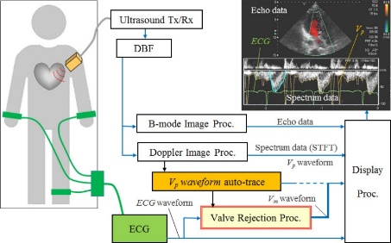

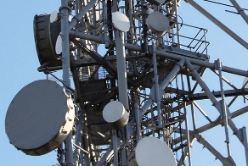
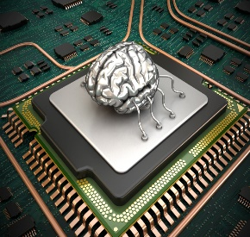
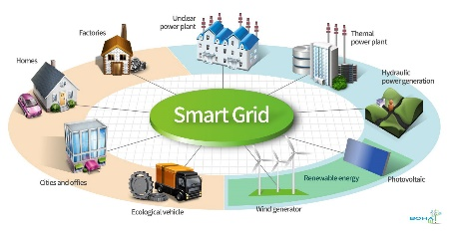

What is DSP
DSP is an enabling science
Real DSP solutions work hand-in-hand with technological developments
DSP algorithms are integrally aligned to DSP architectures (technologies)
Proper DSP designs allow us to produce smaller, cheaper, smarter, and more flexible TOTAL solutions for a diverse range of applications

Slide 7
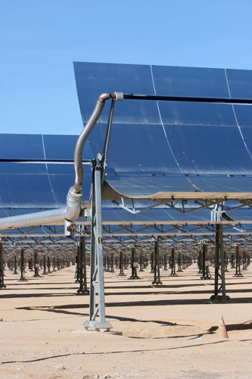

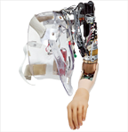

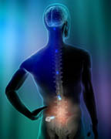
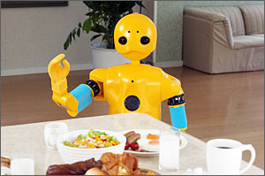

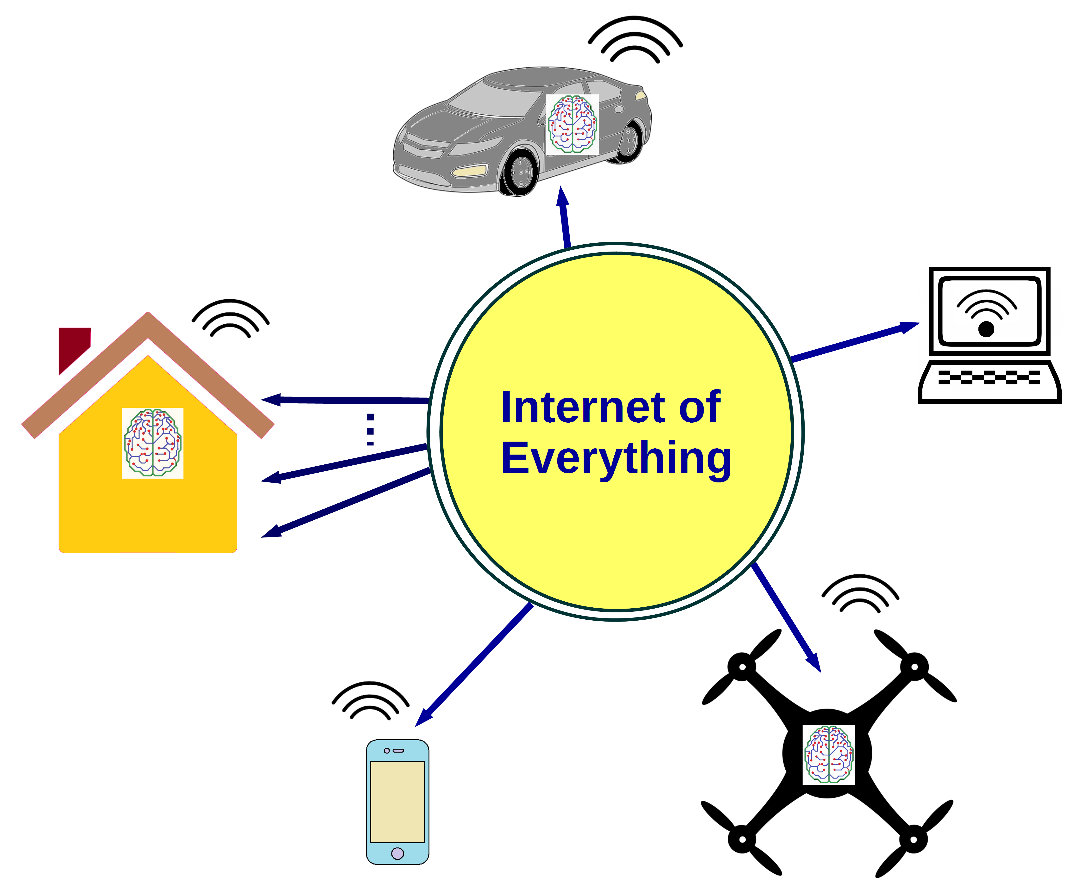


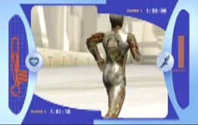
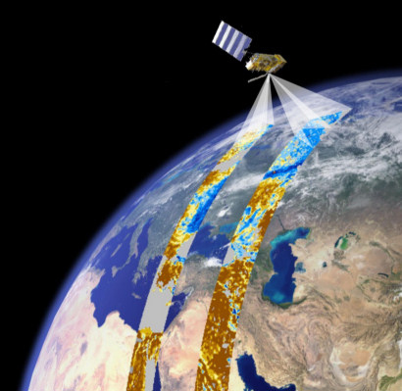
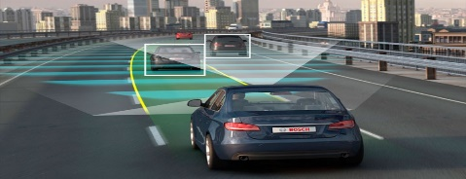
Where do we use DSP?
Green
Robotics
Health
Full immersion
Security & Remote Sensing
IOT & Autonomous Systems
These are just some of the areas in which DSP is used… try to count how many functions and apps do DSP on your smartphone.

Slide 8
Where do we use DSP?
Machine Learning & Deep Learning Neural Networks
SMART Mobile Phones and Wireless Technology
Digital Cameras and Digital Art Technologies
Digital Video recorders (DVR) and Network Video Recorders (NVR)
Speech , audio and music processing
Broadband and Wireless Telecommunication Networks
Radar and Sonar Data processing
Navigation and Tracking Systems
Video Surveillance
Biologically Inspired electronic systems
Seismic, Geophysical and Astronomical Data Interpretation
Biomedical Signal Processing and implanted medical devices
Chemical Data Processing
Virtual Reality, Games, 3-dimensional modelling and Digital Holography
Financial Data Processing
Smart Meters and the Smart Grid
Intelligent Power Supplies
Energy Scavenging devices
Autonomous Systems
Internet of Things (IOT)
… etc

Slide 9
Aim & Learning Objectives
Understand:
Core Maths
Fundamental Principles
Algorithms
Applications
Use:
Design tools
Design, analyse and simulate
Matlab to implement basic DSP algorithms
Pre-requisites:
a basic understanding of continuous linear systems
an eagerness to learn
a basic knowledge of complex numbers

Slide 10
Syllabus Overview
Semester 1
Block 1: Signals & LTI Discrete Systems:
Discrete Signals and Systems
Convolution/Correlation
Cyclic Convolution and Correlation
Overlap Add and Overlap Save methods
Block 3: Fundamental Applications
Time Sampling Nyquist Sampling- Aliasing
Signal Reconstruction (DAC)
Decimation and Interpolation
Block 2: Signal Transforms:
Discrete Fourier Series -- DFT
Z-Transform- Discrete System Analysis
DTFT- DFT Resolution, Spectral Leakage & Scallop Loss
Acquisition, Windowing
Frequency Sampling, DFT
DFT Evaluation -- DFT Matrix Method & FFT
Block 4: Digital Filters
FIR , IIR
Linear Phase Digital Filters
Digital Filter Design
Efficient Multirate Digital Filters
Semester 2
Block 5: Applications:
Time Frequency Representation of Signals
Speech Processing
Radar Signal Processing principles
Matched filtering in radar/sonar
Range-Doppler representation
Micro-Doppler analysis using time-frequency distributions

Slide 11
Available material through myplace
Matlab on a ramp short course – compulsory by week 2
Lecture notes
Lectures slides
Tutorial questions
Matlab lab tasks
Reference Reading material

Slide 12
Reference Material
“Digital Signal Processing:- Principles, Algorithms and Applications” 3rd edition by John Proakis and Dimitris Manolakis, Prentice Hall, ISBN 0-13-394338-9
“Discrete-Time Signal Processing” 2nd edition by Alan Oppenheim and Ronald Schafer, Prentice Hall Inc, ISBN 0-13-754920-2
“Digital Signal Processing: A Computer Based Appoach” 4th Edition Sanjit Mitra, McGraw Hill, ISBN: 978-007-128946-7 , 2011
“Digital Signal Processing” by Monson Hayes, Schaum’s Outline Series, ISBN 0-07-027389-8
“DSP First – A Multimedia Approach” by Mclellan-Schafer – Yoder, Prentice Hall, ISBN : 0-13-243171-8
“Signals and Systems” , Baraniuk et al – available on myplace
Many internet sites such as:
http://www.dspguide.com/ (a free DSP book)

Slide 13
ASSESSMENT EE469
Laboratory (20% - CA1 &CA2)
Matlab on a ramp – compulsory to unlock the matlab grader tasks – weeks 0-2
Set of Matlab tasks to be released before the labs in weeks 2-4-6-8 of each semester (2.5% each). A total of 8 tasks will be released – 4 per semester and graded through matlab grader.
Tasks to be completed by the end of semesters 1 and 2
Theory (30% - CA3 & CA4)
In week 9 of each semester there will be a test on the theoretical content of the module. Each test will be worth up to 15% of the final mark.
The test will be composed of open and closed solution questions.
EXAM (50%)
End of year exam, 3 questions out of 5offered.

Slide 14
ASSESSMENT EE669
Laboratory (30% - CA1)
Matlab on a ramp – compulsory to unlock the matlab grader tasks – weeks 0-2
Set of Matlab tasks to be released before the labs in weeks 2-4-6-8 (7.5% each). A total of 4 tasks will be released and graded through matlab grader.
Tasks to be completed by the end of semester 1
Theory (35% - CA3)
In week 9 of each there will be a test on the theoretical content of the module.
The test will be composed of open and closed solution questions.
DSP topic (35%-CA5)
Each student selects a DSP topic and is asked to produce a short video presentation (10 minutes) about the topic. (28%)
Additionally, each student is asked to watch 2 other videos (assigned randomly) and to engage via a forum with the author in an asynchronous Q&A session. (7%)- Subject to cohort numbers
Submission end of Semester 1.

Slide 15
ASSESSMENT EE869
Laboratory (40% - CA1)
Matlab on a ramp – compulsory to unlock the matlab grader tasks – weeks 0-2
Set of Matlab tasks to be released before the labs in weeks 2-4-6-8 (10% each). A total of 4 tasks will be released and graded through matlab grader.
Tasks to be completed by the end the semester
Theory (20% - CA3)
In week 9 of each there will be a test on the theoretical content of the module.
The test will be composed of open and closed solution questions.
DSP topic (40%-CA5)
Each student selects a DSP topic and is asked to produce a short video presentation (10 minutes) about the topic. (30%)
Additionally, each student is asked to watch 2 other videos (assigned randomly) and to engage via a forum with the author in an asynchronous Q&A session. (5%)
By the end of semester 1 the topics is assigned and students are asked to submit a short abstract (1-2 pages). (5%)
Submission end of Semester 2.

Slide 16
ASSESSMENT EE969
Laboratory (20% - CA1 &CA2)
Matlab on a ramp – compulsory to unlock the matlab grader tasks – weeks 0-2
Set of Matlab tasks to be released before the labs in weeks 2-4-6-8 of each semester (2.5% each). A total of 8 tasks will be released – 4 per semester and graded through matlab grader.
Tasks to be completed by the end of semesters 1 and 2
Theory (30% - CA3 & CA4)
In week 9 of each semester there will be a test on the theoretical content of the module. Each test will be worth up to 15% of the final mark.
The test will be composed of open and closed solution questions.
DSP Topic (10%- CA5)
Each student selects a DSP topic and is asked to produce a short video presentation (10 minutes) about the topic (in the past they were asked to write a conference paper). (7%)
Additionally, each student is asked to watch 2 other videos (assigned randomly) and to engage via a forum with the author in an asynchronous Q&A session. (3%)
Submission at the end of Semester 2
EXAM (40%)
End of year exam, 3 questions out of 5 offered.

Slide 17
Delivery method
Lectures
Live lectures
Tutorials
Laboratories
Matlab tasks released on the lab day through myplace;
Matlab tasks to be completed and submitted asynchronously via matlab grader.

Slide 18
Interacting with the teaching team
Use the Forums on myplace
Contact us via e-mail.
carmine.clemente@strath.ac.uk
j.zabalza@strath.ac.uk
c.ilioudis@strath.ac.uk

Slide 19
Questions?

Slide 20
Intro to DSP
Introduction to DSP
carmine.clemente@strath.ac.uk

Slide 21
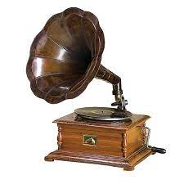


Historical notes
Until the early 1950s the extraction of information from signals was performed exclusively with analog systems implemented with electronic circuits or even mechanical devices;
With the growing availability and more general capabilities of digital computers the use of DSP became more and more diffused until today with the vast majority of signals processed digitally;
From this…
to this
Digital
Analog

Slide 22
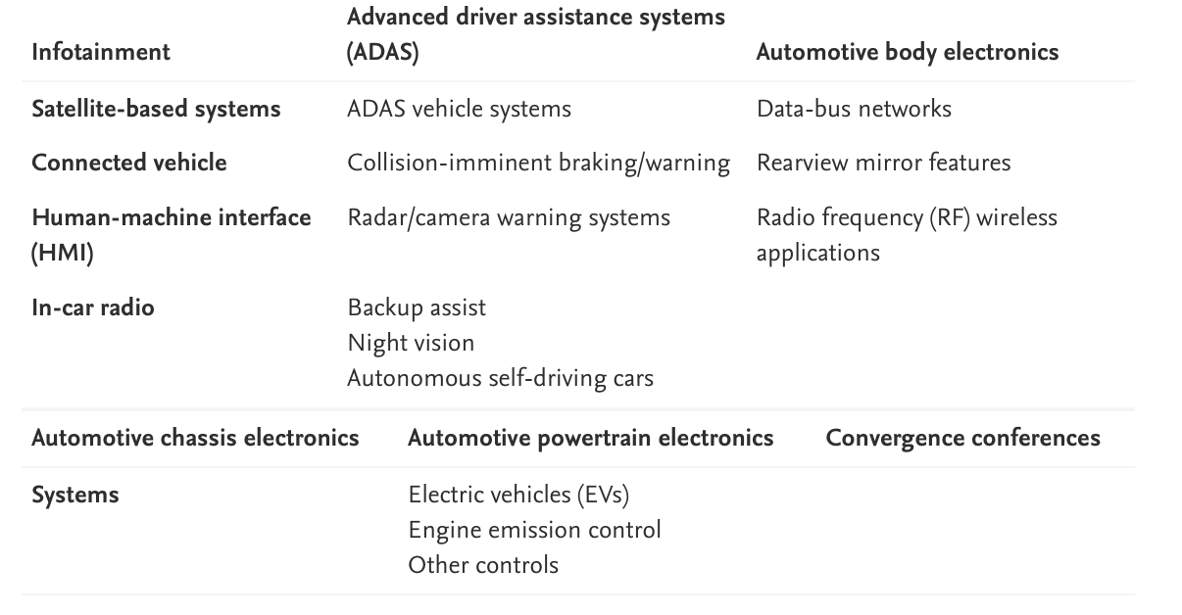
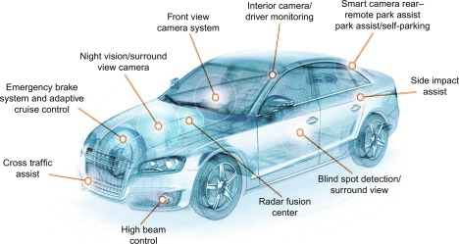
Introduction to DSP
DSP represents an enabling technology with solid history and great future thanks to the synergy of theoretical development, sophisticated applications and constantly emerging new hardware.
We have already listed a broad set of application domains in which DSP plays a fundamental role, but to give you an idea let us analyse an example:
Electronics systems on a modern car:
ADAS System

Slide 23
Introduction to DSP
Signal processing deals with the representation, transformation, and manipulation of signals and the information the signals contain;
Examples are separating two signals (e.g. useful and interferer) or estimate a signal parameter (e.g. time difference or angle of arrival);
When we talk about Digital Signal Processing and/or Discrete time signal processing we generally refer to signals whose time variable is the independent variable, however, without loss of generality the discrete independent variable could be anything (e.g. space, angle);
Income [$]
Amplitude [V]
Time [s]
Sales [#]

Slide 24
Basic Elements of a DSP System
Most of the signals encountered in science and engineering are of analog nature, indeed they are functions of a continuous variable (time, space, etc) and can take values in a continuous range.
These signals can be processed using an analog signal processor:
Analog Input
Analog signal processor
Analog Output

Slide 25
Basic Elements of a DSP System
Digital Input signal
Digital Output signal
Analog Input
Analog Output
A/D converter
Digital Signal Processor
D/A converter
DSP provides an alternative to the analog signal processor by processing the information digitally;
Introduces the need for an interface between the analog and the digital world in input and (not always) in output.
The analog to digital converter (A/D) is the required interface to convert the input signal in a digital version, while the Digital to analog converter (D/A) is used to convert the processed output in analog form;
The Digital Signal Processor can be a large programmable computer, a dedicated programmable chip or a hardwired digital processor.

Slide 26
Advantages of DSP
Flexibility: operations can be easily reconfigured by changing the program (not easy in an analog system);
Accuracy control: analog systems include tolerance that need to be taken into account, digital systems provide higher level of control on the accuracy;
Storage and portability: Digital signals are much easier to store on memory support and to port on other media;
Processing complexity: using software it is possible to implement very complex operations on signals that would have required extremely complex hardware if performed in analog;
Cost: thanks to the general purpose of many DSP processors and the lack of the design of dedicated HW, the cost of DSP system is significantly less of an analog processor.

Slide 27
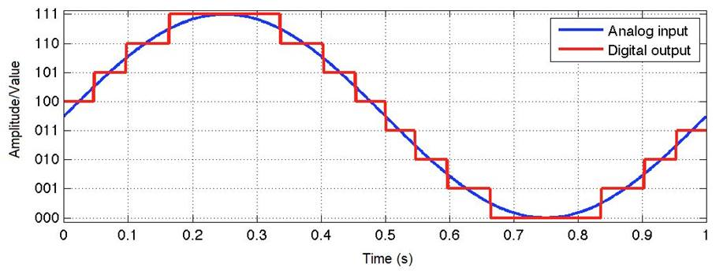
Drawback of DSP
A/D conversion speed: the main drawback is the need to have A/D converters fast enough to handle signals with rapidly changing characteristics, meaning that for signals with large bandwidths the cost explodes or analog systems must be used;
However technology is improving year after year making A/D converter capabilities always better.

Slide 28
Complex Exponential
Complex Exponential
carmine.clemente@strath.ac.uk

Slide 29
The Complex Exponential
The complex Exponential plays a key role in DSP, as you will see, we will use the complex exponential in a number of DSP tools and techniques throughout the course (i.e. DFS, DFT, FFT, frequency analysis);
The complex exponential is composed by a sine and a cosine:

Slide 30
The Complex Exponential
How do we get to this definition?
Lets say we want a function so that:
and that at the same time a condition on its derivative is satisfied too
The complex exponential is the only function satisfying this relationship
Indeed the derivative is:
This is called Euler’s Formula

Slide 31
The Complex Exponential
To demonstrate the use of the exponential notation, prove (as an exercise) the following form of the Law of Exponents:
To prove this expand the right-hand side and use the trigonometric identities:
2. Also show that
To prove it just write the right hand side of both equations in terms of cosine and sine
This is called De Moivre’s Theorem

Slide 32
The Complex Exponential
Now we want to find out specific values of the complex exponential (e.g $e^{jπ}, e^{\frac{jπ}{2}},e^{\frac{−jπ}{2}},e^{j2π}$);
Recall that the relationship between cartesian coordinates $(x,y)$ and polar coordinates $(r,θ)$ of a point is:
Making use of Euler’s formula, we can express polar representation in the following manner:
Where
Is the Magnitude
Is the Phase

Slide 33
The Complex plane
Imaginary axis
Real axis

Slide 34
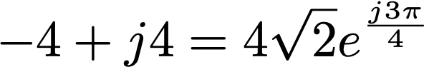
Complex Exponential Example
Let us consider with
Therefore
Note also that, due to the periodicity of sine and cosine (i.e. both have fundamental period of 2π) , if z = re^{jθ}, then we also have
Thus, in our last example,
Exercise: Sketch these on the complex plane to convince yourself

Slide 35
Complex Plane Example
Express points A, B, C and D as general complex numbers in Polar and Cartesian Form if the magnitude of all these points is 1.
B
C
A
D

Slide 36
Signal Classification and ADC
Signal Classification
carmine.clemente@strath.ac.uk

Slide 37
Signal Classification
The term signal is generally applied to something that conveys information;
Signals can be represented in may ways, however information is conveyed via some sort of pattern or variation;
Signals are generally represented as mathematical functions of one or more independent variable (usually time);
Continuous-time signals are defined along a continuum time and are thus represented by a continuous independent variable;
Discrete-time signals are defined at discrete times, thus the independent variable has discrete values;
Discrete-time signals are represented as a sequence of numbers;
Signals such as images or speech can be represented both as continuous and discrete, and under certain conditions the two representations are equivalent.

Slide 38
Continuous Time Signals
An example of a Continuous Time – Continuous Amplitude signal on the time interval t = [0,1];
and an example of Continuous Time- Discrete Amplitude signal on the time interval t = [0,1] and Quantized with an interval of Q = 0.1.

Slide 39
Discrete Time Signals
An example of a Discrete Time – Continuous Amplitude signal sampled at 50 Hz on the interval n =[0,50];
and an example of Discrete Time- Discrete Amplitude signal sampled at 50 Hz on the interval n=[0,50] and Quantized with an interval of Q = 0.1.

Slide 40
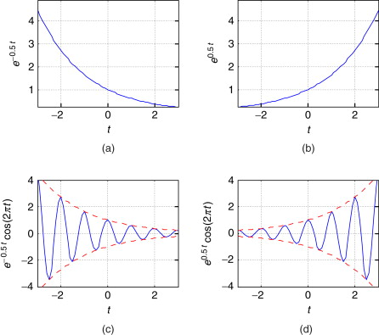
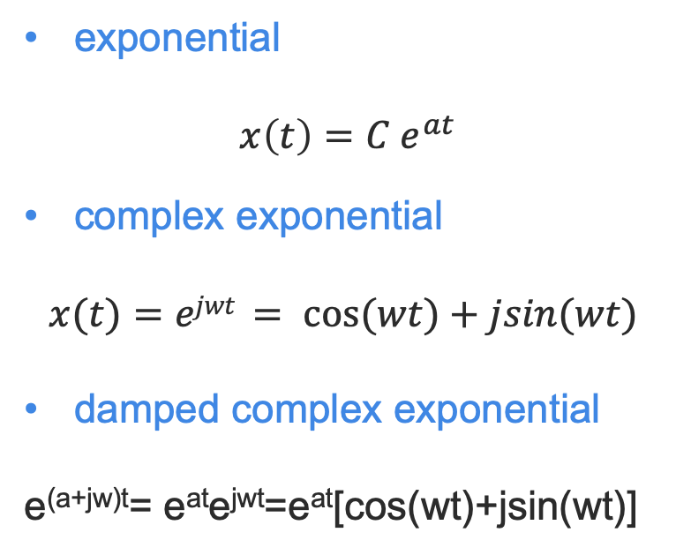
Fundamental Discrete Signals
exponential
$$x\left(t\right)=C e^{at}$$
complex exponential
$$x(t)=ejwt = cos⁡(wt)+jsin(wt)$$
damped complex exponential
e^{(a+jw)t}= e^{at}e^{jwt}=e^{at}[cos(wt)+jsin(wt)]

Slide 41
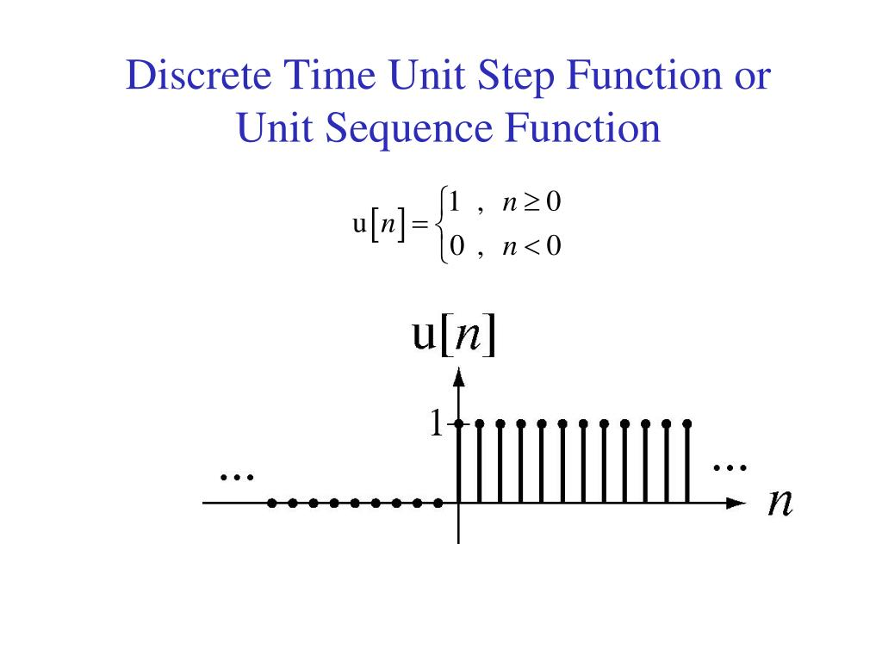
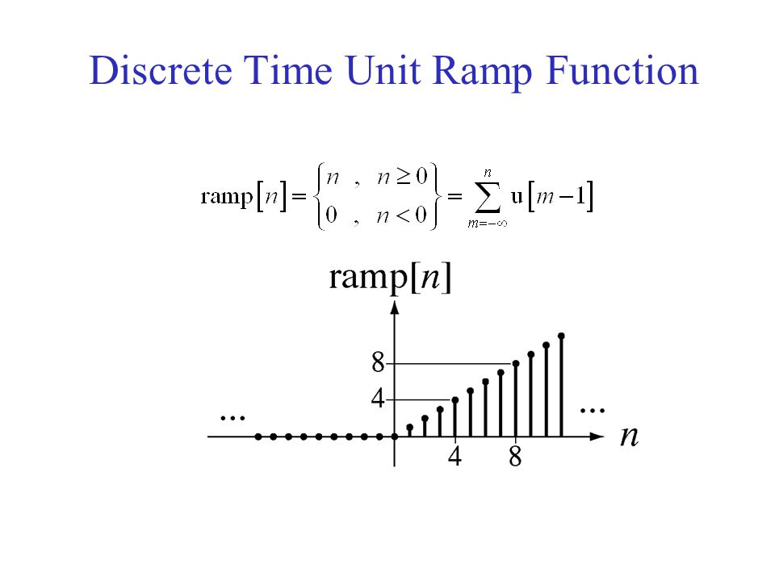
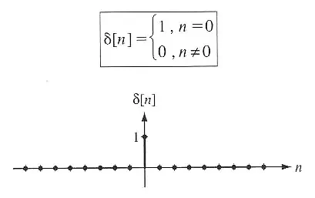
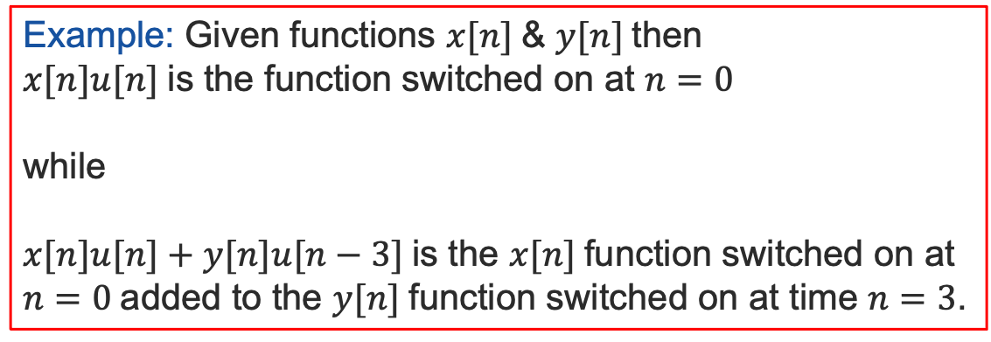
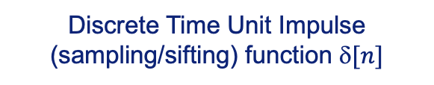
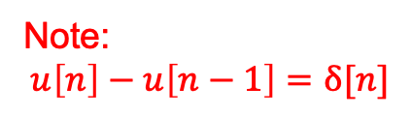
Fundamental Signals
Example: Given functions $x[n]$& $y[n]$then
$x[n]u[n]$is the function switched on at $n=0$
while
$x[n]u[n]+y[n]u[n−3]$is the $x[n]$function switched on at $n=0$added to the $y[n]$function switched on at time $n=3$.
Discrete Time Unit Impulse (sampling/sifting) function $[n]$
Note:
$$u\left[n\right]−u\left[n−1\right]=δ[n]$$
Like the RELU function in Deep Learning

Slide 42

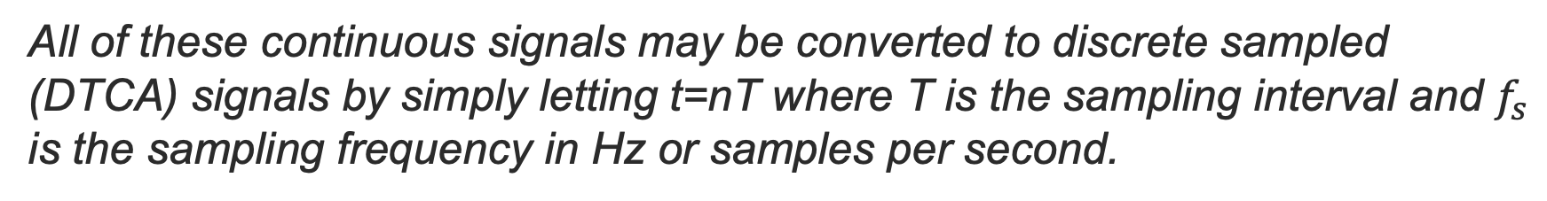
Fundamental Discrete Signals
All of these continuous signals may be converted to discrete sampled (DTCA) signals by simply letting t=nT where T is the sampling interval and $f_{s}$
is the sampling frequency in Hz or samples per second.
such that $x(t)$ becomes $x(nT) = x[n]$
The square brackets means the sampling interval T is implied

Slide 43
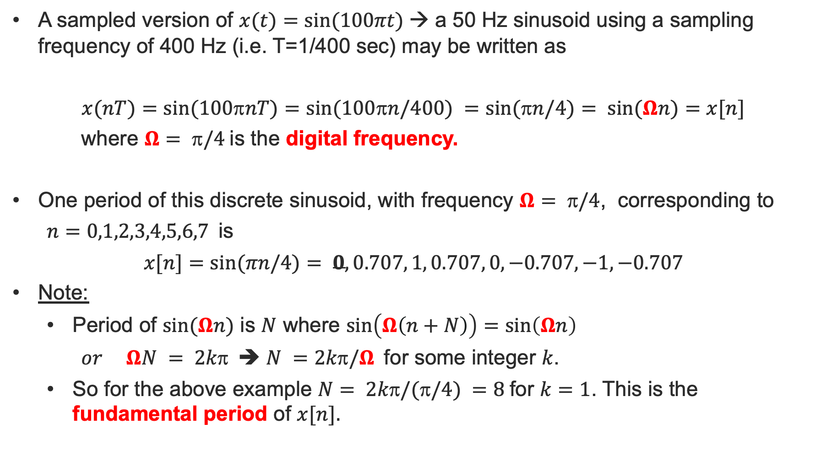
Digital freq./fundamental Period
A sampled version of $x(t)=sin⁡(100πt)$→ a 50 Hz sinusoid using a sampling frequency of 400 Hz (i.e. T=1/400 sec) may be written as
$$x(nT)=sin⁡(100nT)=sin⁡(100n/400) =sin⁡(n/4)= sin⁡(Ωn)=x[n]$$
where $Ω= /4$is the digital frequency.
One period of this discrete sinusoid, with frequency $Ω= /4$, corresponding to
$n=0,1,2,3,4,5,6,7$is
$$x[n]=sin⁡(πn/4)= 0, 0.707, 1, 0.707, 0, −0.707, −1, −0.707$$
Note:
Period of $sin⁡(Ωn)$ is $N$ where $\sin\left(Ω\left(n+N\right)\right)=\sin\left(Ωn\right)$
$or ΩN = 2k$➔ $N =2k/Ω$for some integer $k$.
So for the above example $N= 2k/(/4) =8$for $k=1$. This is the fundamental period of $x[n].$

Slide 44
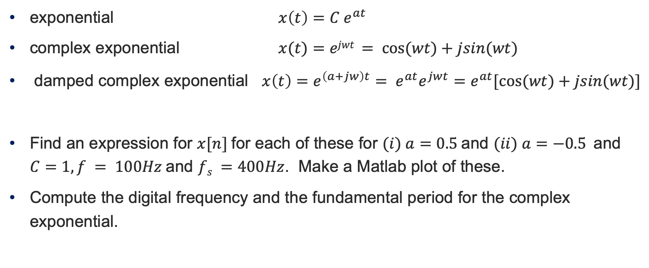
Discrete Complex Exponential – Exercises
exponential $x\left(t\right)=C e^{at}$
complex exponential $x(t)=ejwt = cos⁡(wt)+jsin(wt)$
damped complex exponential $x\left(t\right)=e^{\left(a+jw\right)t}= e^{at}e^{jwt}=e^{at}[cos⁡(wt)+jsin(wt)]$
Find an expression for $x[n]$for each of these for $(i) a=0.5$and $(ii) a=−0.5$and $C=1, f = 100Hz$and $fs =400Hz$. Make a Matlab plot of these.
Compute the digital frequency and the fundamental period for the complex exponential.

Slide 45
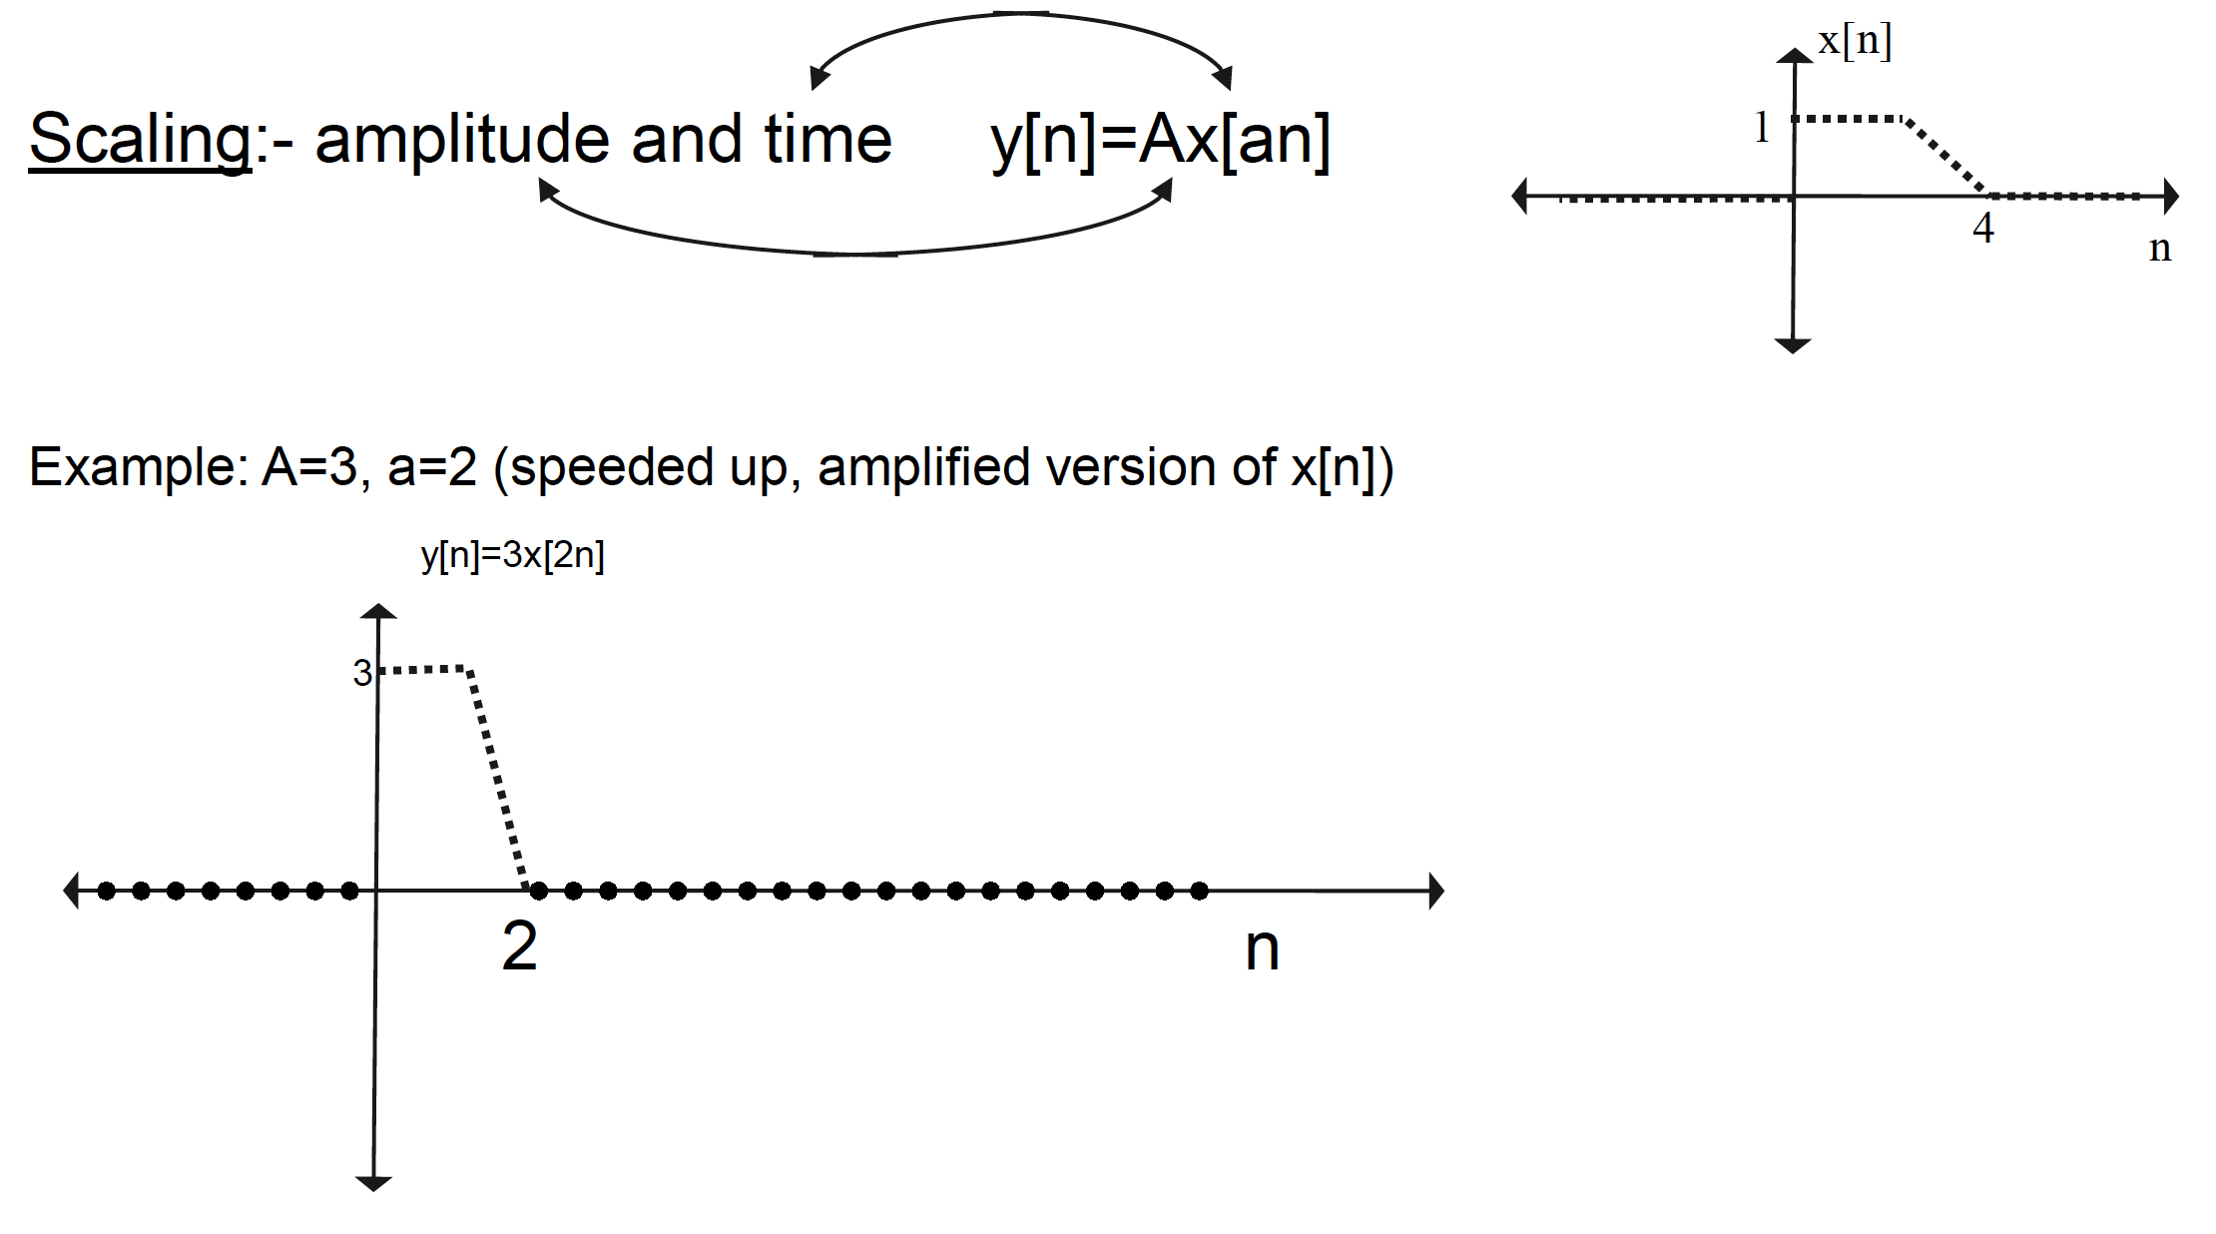

Operations on Signal $x[n]$

Slide 46
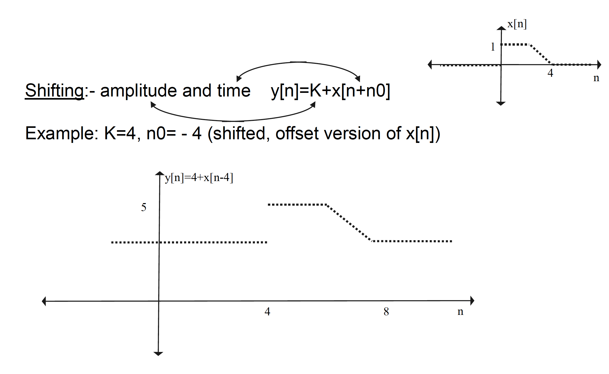
Operations on Signal $x[n]$

Slide 47
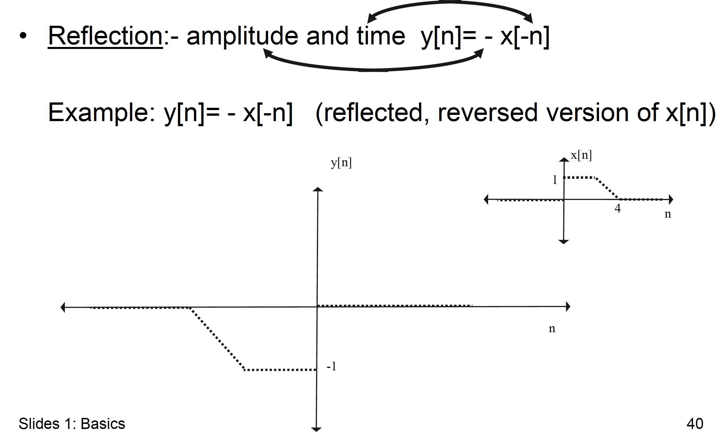
Operations on Signal $x[n]$

Slide 48
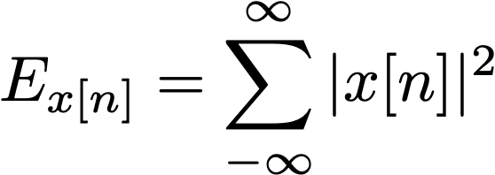
Energy and Power
Energy and Power of a discrete signal are important measures of this type of signals
For aperiodic signals it is possible to define the energy of a discrete signal as
Instead, for periodic signals, the energy is infinite, so we need to compute its power
the power is the average energy in one period.

Slide 49
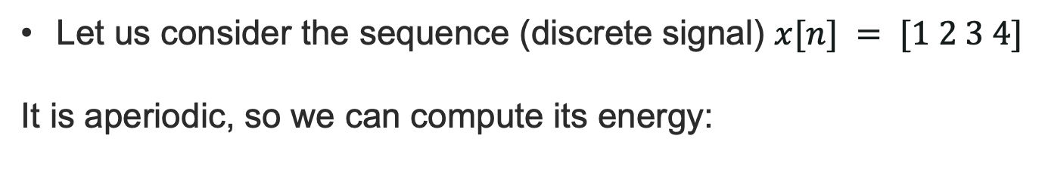
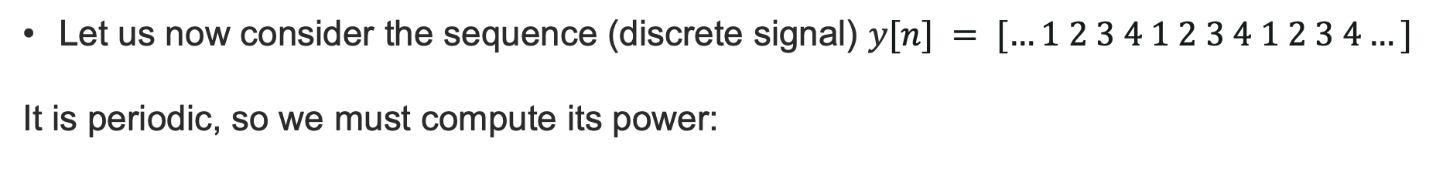
Energy and Power - Example
Let us consider the sequence (discrete signal) $x[n] = [1 2 3 4]$
It is aperiodic, so we can compute its energy:
Let us now consider the sequence (discrete signal) $y[n] = […1 2 3 4 1 2 3 4 1 2 3 4…]$
It is periodic, so we must compute its power:

Slide 50
Properties and visualization
Properties and Visualization
carmine.clemente@strath.ac.uk

Slide 51
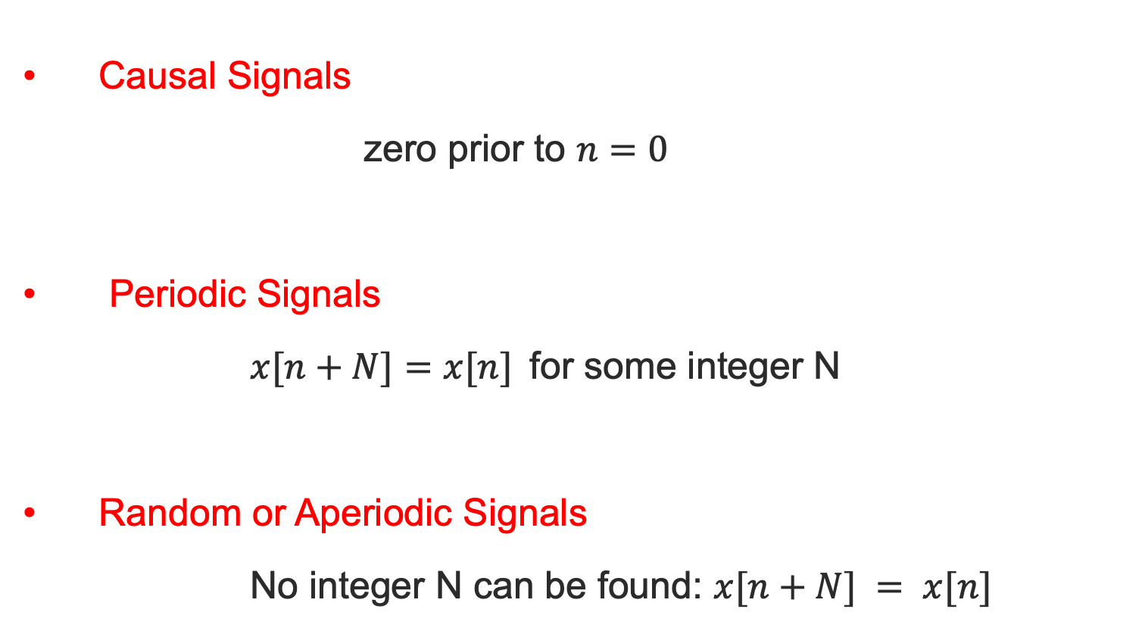
Some Signal Properties
Causal Signals
zero prior to $n=0$
Periodic Signals
$x[n+N]=x[n]$for some integer N
Random or Aperiodic Signals
No integer N can be found: $x[n+N] = x[n]$

Slide 52
Signal Visualization
Time Plot:
x[n] versus n
Frequency Plots:
one-sided Magnitude and Phase Spectra;
two-sided Magnitude and Phase Spectra.
Time-Frequency Plots:
Magnitude Spectra versus time on the time- frequency plane

Slide 53
Signal Visualization
Draw the Time Plot & Frequency plots of a 125Hz Sine wave sampled at fs=1000Hz
One-sided Spectrum of x[n]

Slide 54
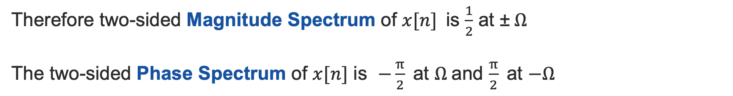
Signal Visualization
Draw the Time Plot & Frequency plots of a 125Hz Sine wave sampled at fs=1000Hz
Two-sided Spectrum of x[n]
Using Euler to convert to two-sided form
Therefore two-sided Magnitude Spectrum of $x[n]$is $\frac{1}{2}$ at ±$Ω$
The two-sided Phase Spectrum of $x[n]$ is $−\frac{π}{2}$at $Ω$and $\frac{π}{2}$at $−Ω$

Slide 55
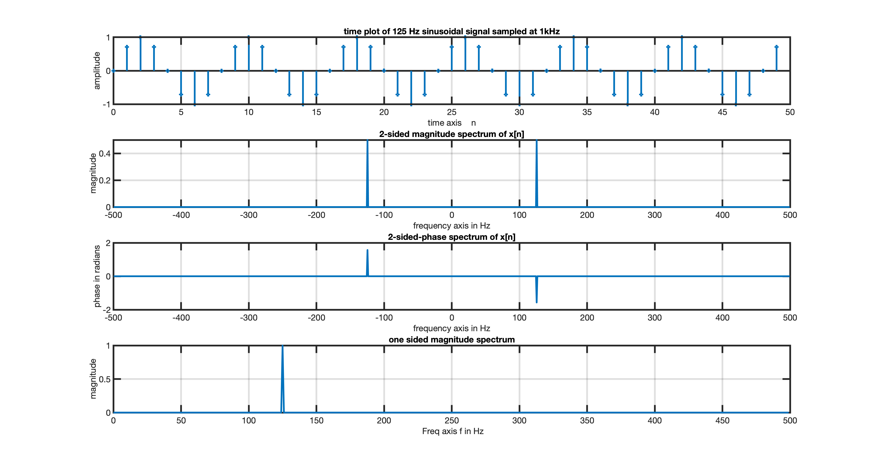
Signal Visualization

Slide 56
Matlab Code
function plot_spectra(nsamp,f,fs)
close all
if nargin == 0
nsamp=1000; f=125; fs=1e3;
end
figure ; n=[0:1:nsamp-1] ; t=n/fs;
faxis=[(-nsamp+1)/2:1:nsamp/2]; faxis_onesided=[0:1:(nsamp-1)/2];
faxis=faxis*fs/nsamp; faxis_onesided=faxis_onesided*fs/nsamp;
x=sin(2*pi*f*t);
subplot(4,1,1); stem(n(1:50),x(1:50))
xlabel('time axis n'); ylabel('amplitude')
title('time plot of 125 Hz sinusoidal signal sampled at 1kHz');grid
subplot(4,1,2); ft=fft(x)/nsamp; ft2=fftshift(ft);ft1=ft(1:nsamp/2)
plot(faxis,abs(ft2)); grid
title('2-sided magnitude spectrum of x[n]')
xlabel('frequency axis in Hz'); ylabel('magnitude')
subplot(4,1,3)
ang_ft2=angle(ft2);
ang_ft2(abs(ft2) < 0.01) = 0; % used to avoid random phases
plot(faxis,ang_ft2)
title('2-sided-phase spectrum of x[n]')
xlabel('frequency axis in Hz'); ylabel('phase in radians'); grid
subplot(4,1,4)
plot(faxis_onesided,2*abs(ft1)), ylabel('magnitude')
xlabel(' Freq axis f in Hz')
title('one sided magnitude spectrum')
grid

Slide 57
X THE PLACE OF USEFUL LEARNING

